Slide 1
Mobile Phone Pricing
FCCA Team 6
Cai Jia Wei
Revathi Selvasevaran
Sivagurunathan Keerthivasan

Slide 2
Table of contents
01
02
03
04
05
06
Introduction
EDA & Linear Regression
Categorical Analysis &
Random Forest
Neural Network
Concluding Remarks
Resources

Slide 3
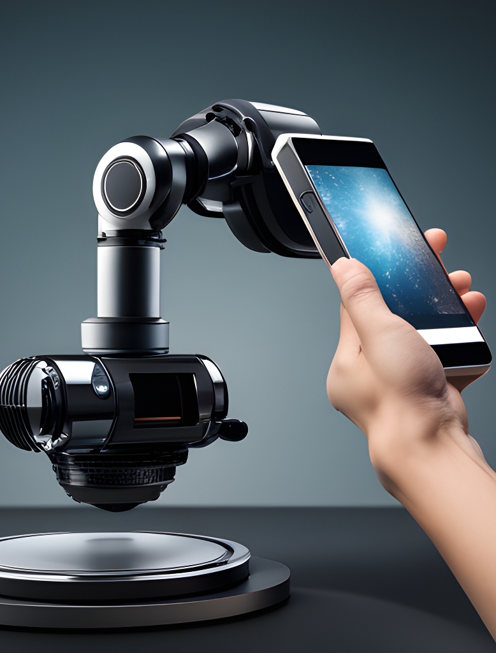
Problem Definition
This project hopes to answer:
What are the main specifications that contribute to mobile phone prices?
Given the specifications of a phone to be launched, can I then determine the price it may be sold for?
Data sourced from Kaggle Dataset on Mobile Phone Specifications and Price spanning 1 Jan 2020 -30 May 2020, 5 months.
Notes:
One device you cannot go without is a smartphone. There are large price variation between mobile phones on basis of various factors.

Slide 4
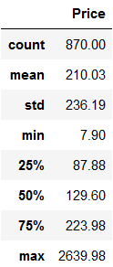
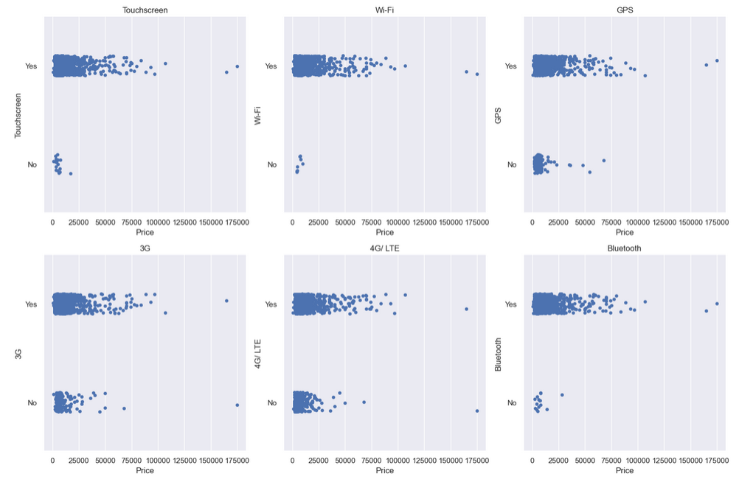
EDA
Cleaning of Data Sets
Conversion of Price (INR to SGD)
Removal of Columns for undesirables (Touchscreen, Wi-Fi, GPS, 3G, 4G/LTE, Bluetooth)
Rationale: Assume no modern consumer would want a smartphone without the features above
Merging Resolution X & Y
Univariate Analysis
Bivariate Analysis
Notes:
One device you cannot go without is a smartphone. There are large price variation between mobile phones on basis of various factors.

Slide 5
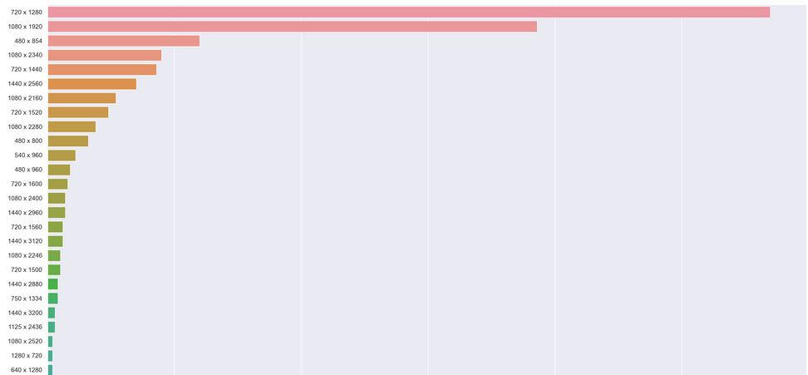
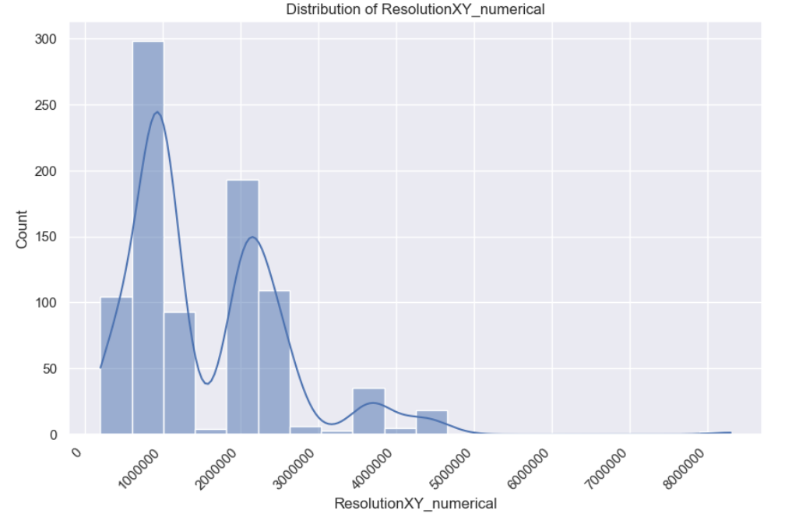
Univariate Analysis - Resolution_X, Resolution_Y
Resolution X by Y (Numerical)
Resolution X and Resolution Y columns combined to give us a pixel count.
First Peak
Between 480P-1080P video encoding resolutions
Second Peak
Between 1080p & 2160p video encoding resolutions
Resolution X by Y (Categorical)
Resolution X and Resolution Y columns combined to give us a pixel count.
The 3 most common phone resolutions are:
720 x 1280
1080 x 1920
480 x 854

Slide 6
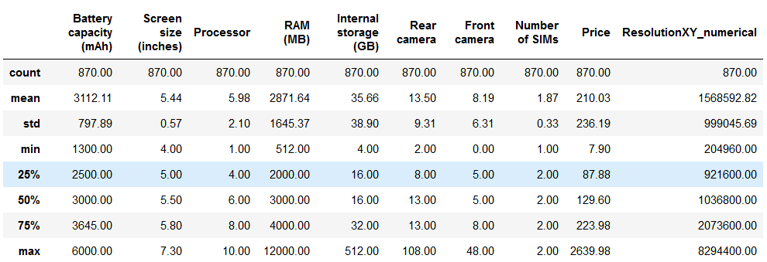
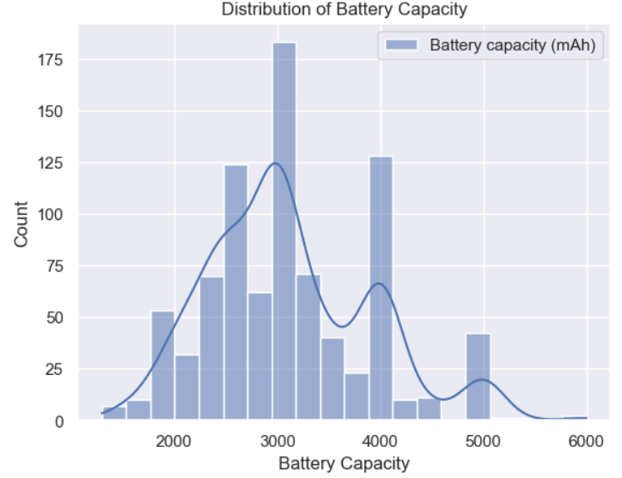
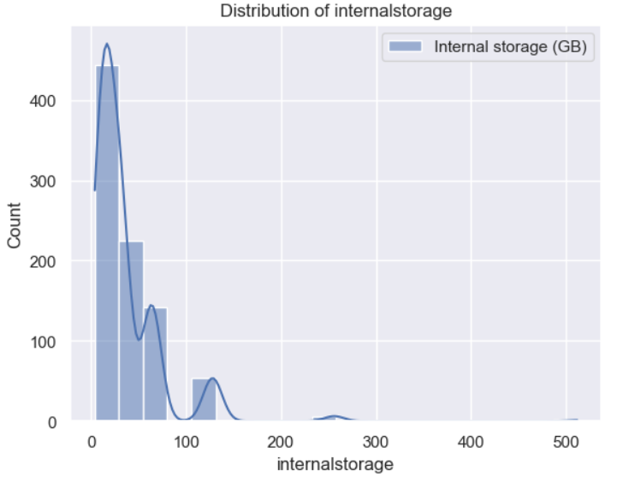
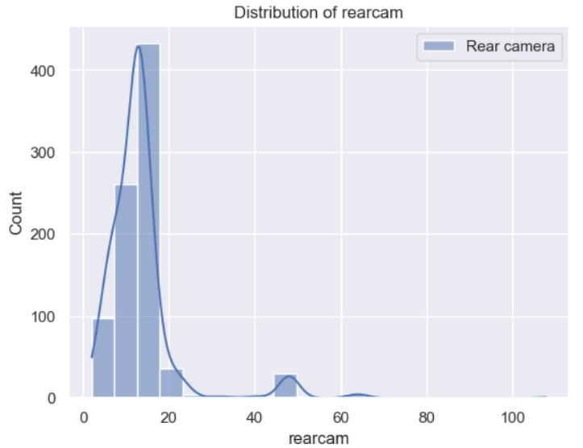
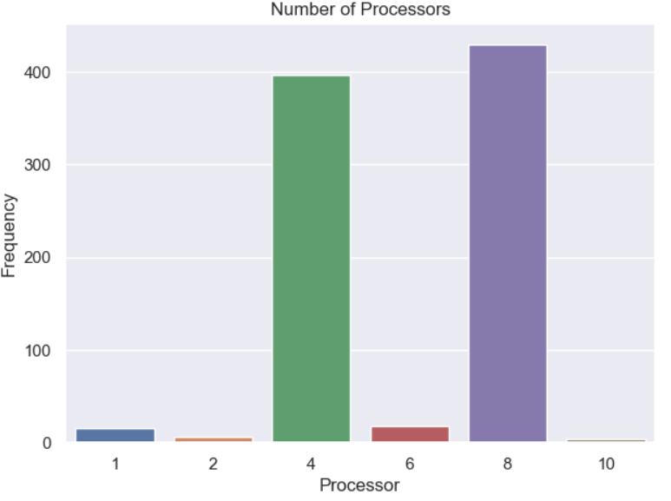
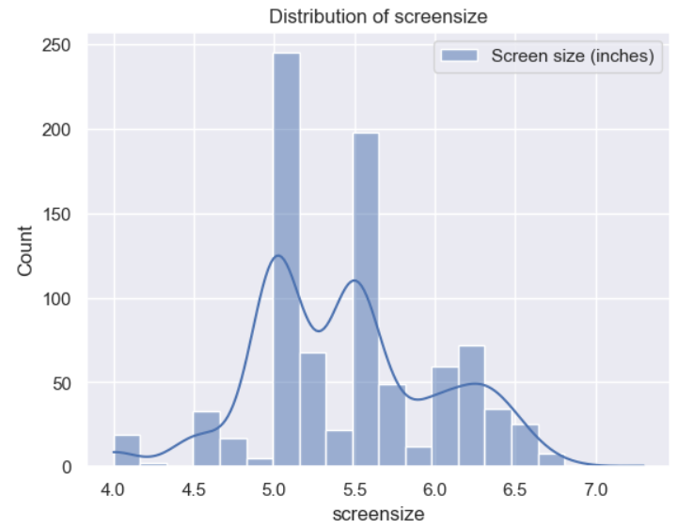
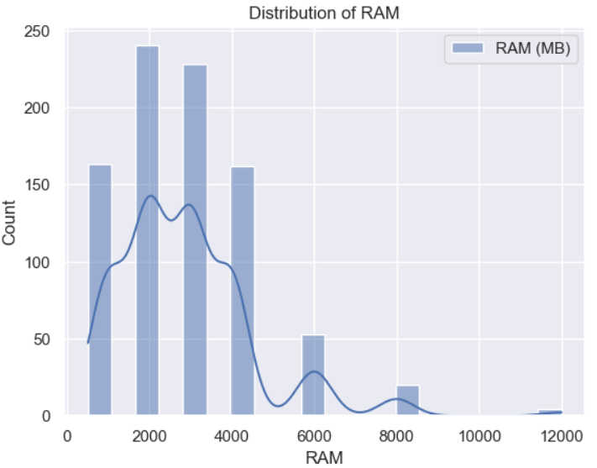
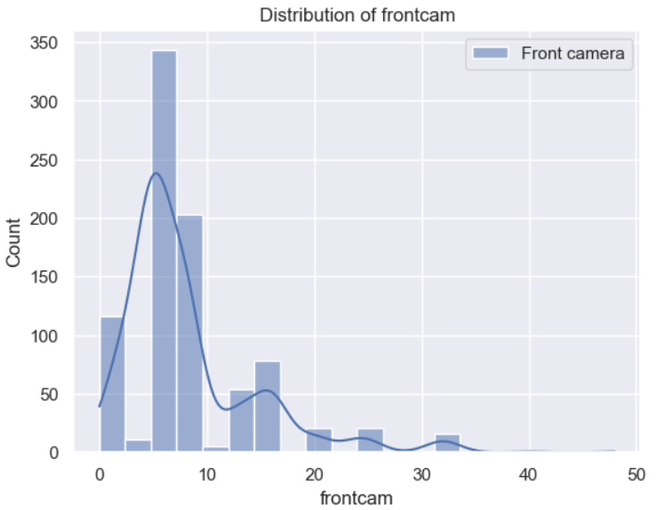
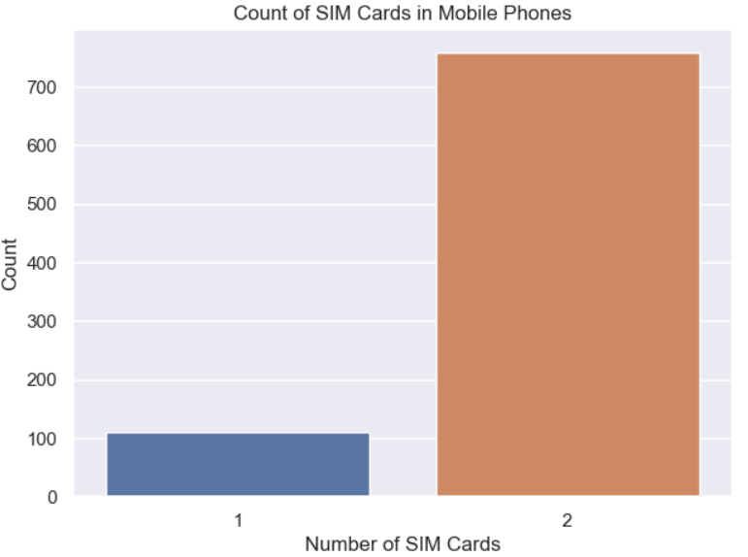
Univariate Analysis
Numerical
Categorical
Notes:
Unique RAMs:[12000 6000 4000 8000 3000 2000 1000 512 768]
From this we can tell there is a clear distinction between RAM data. Data is split into 9 unique processors

Slide 7
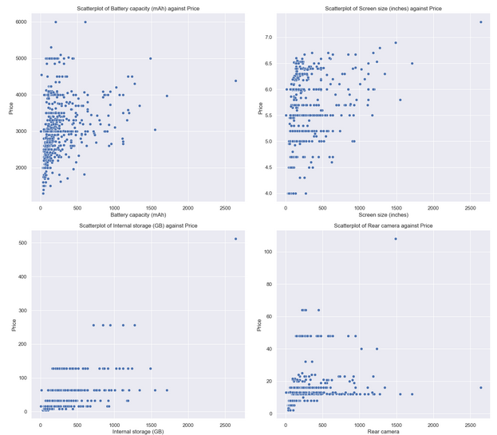
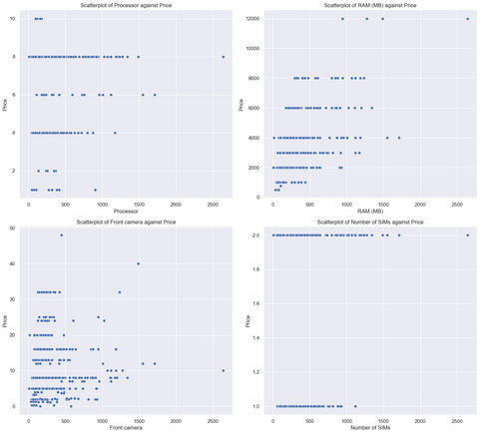
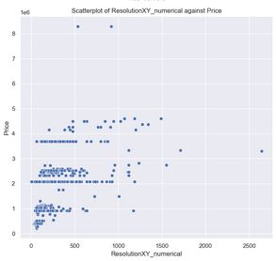
Bivariate Analysis - Parameters Against Price
Battery Capacity - mAh
Screen Size - inches
Internal Storage - GB
Rear Camera - MP
Processor - qty
Internal Memory - RAM
Front Camera - MP
SIM - Single/Dual
Resolution_XY - Pixels
Notes:
We have now achieved a better understanding of the data and can better classify the data for Categorical columns and Numerical data:
Categorical columns: Brands, Operating system ,Resolution x * Resolution y,Processor, RAM(MB), Internal storage (GB), Number of SIMs
In short,
Numerical columns: Battery capacity, Screen size, Rear camera and Front camera
The numerical variables to consider for our prediction model(s): RAM, Internal storage
The categorical variables to consider for our prediction model(s): Brands

Slide 8
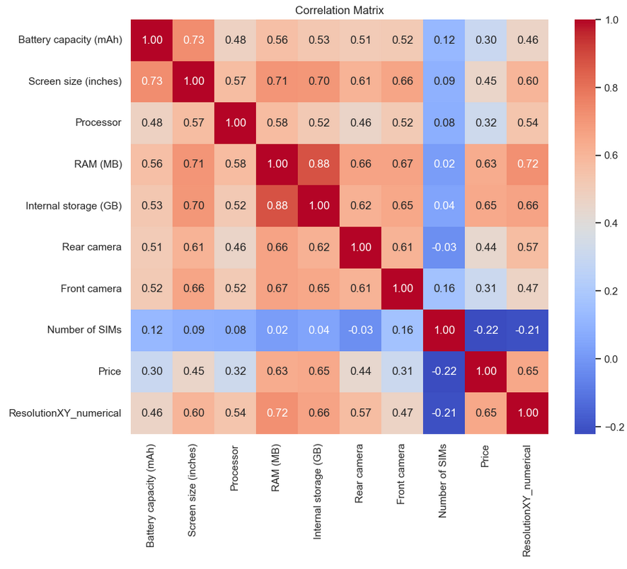
Linear Regression Modelling (LRM) for
Price Prediction
After Normalisation of Skew Positive Data with SQRT
Focus on:
RAM (MB) -0.63
Internal Storage (GB) - 0.65
Resolution X*Y - 0.65

Slide 9
Linear Regression Modelling (LRM) for Price Prediction
Attribute /Model | Bivariate RAM (MB) | Bivariate Internal Storage (GB) | Multivariate (RAM, IS & Resolution XY)
Intercept, b | -42.67664977 | 73.97194258 | -31.4
Coefficient(s), a_{i} | 0.08896845 | 3.95066333 | 0.022305, 0.831257, 0.000092
Goodness of Fit (R²) | 0.34 (Train) 0.45 (Test) | 0.38 (Train) 0.42 (Test) | 0.39 (Train) 0.54 (Test)
Root Mean Squared Error (RMSE) ($ est +/-) | 191.73 (Train) 173.20 (Test) | 194.73 (Train) 148.40 (Test) | 172.43 (Train) 186.93 (Test)

Slide 10
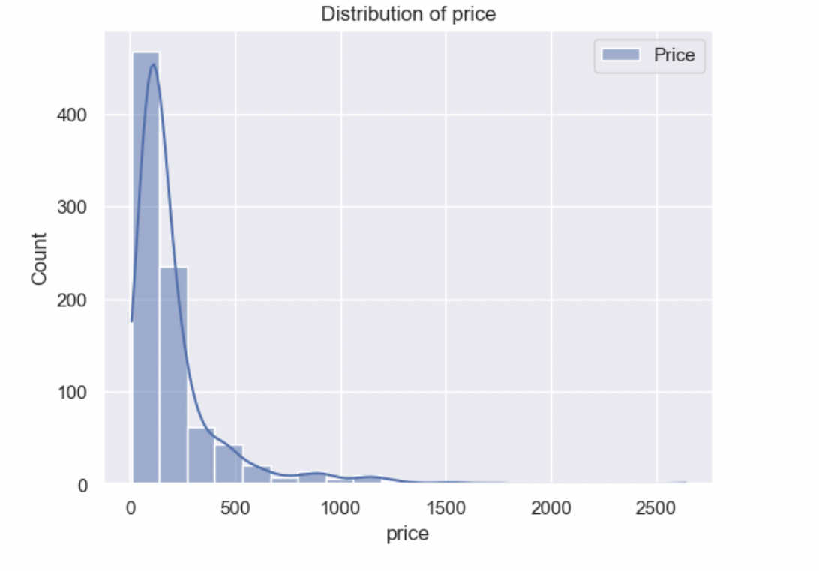
Categorical Analysis
Due to the lack of diversity in the price of the data, we decided to split them into different price ranges: Low priced phone, mid price phone and high priced phone
Low priced phones are in the 25th quantile
High priced phones are in the 75th quantile
The remaining will be your mid priced phone

Slide 11
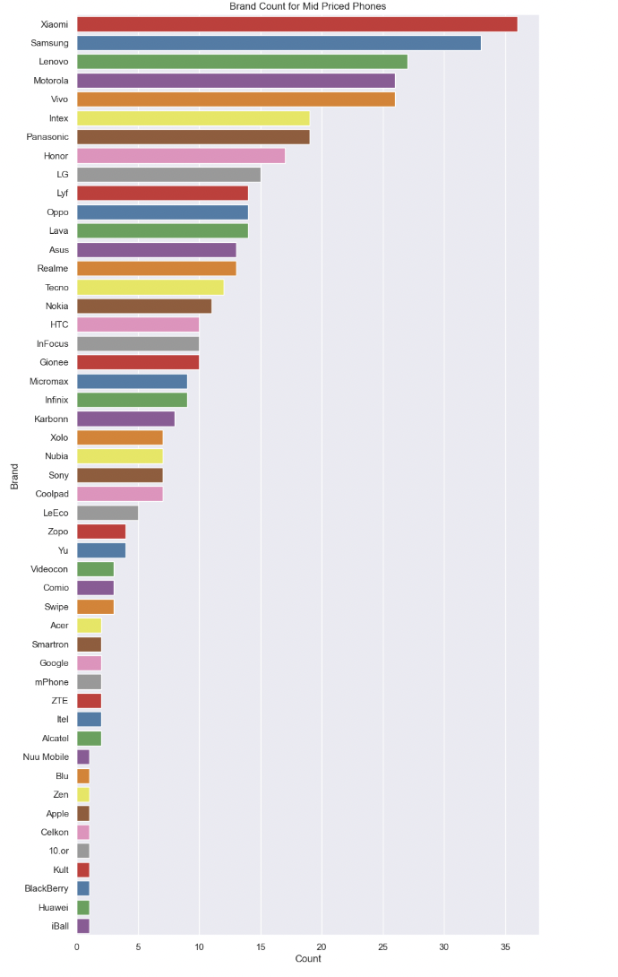
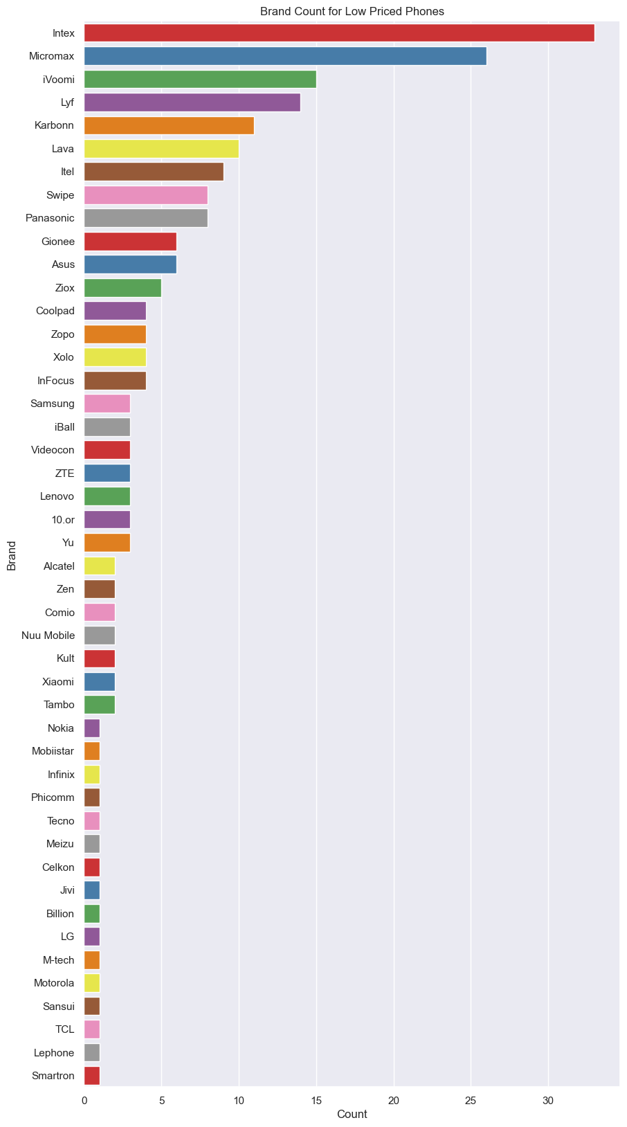
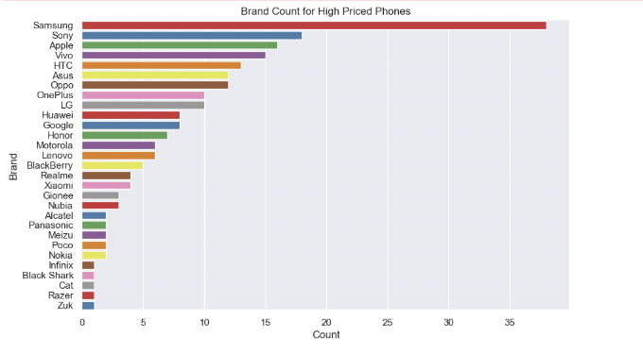
Categorical analysis
The brand of the phone also played a major role in the price of the phone:
High-priced phones
Mid-priced phones
Low-priced phones

Slide 12
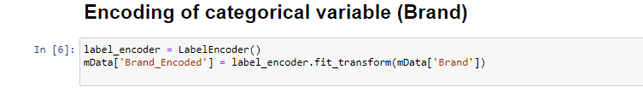
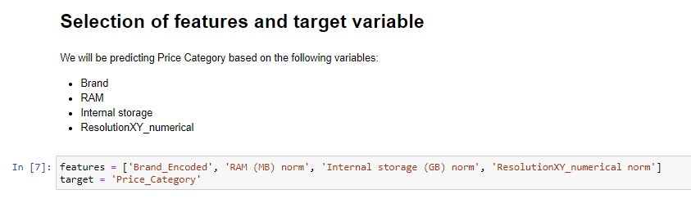
Random Forest

Slide 13
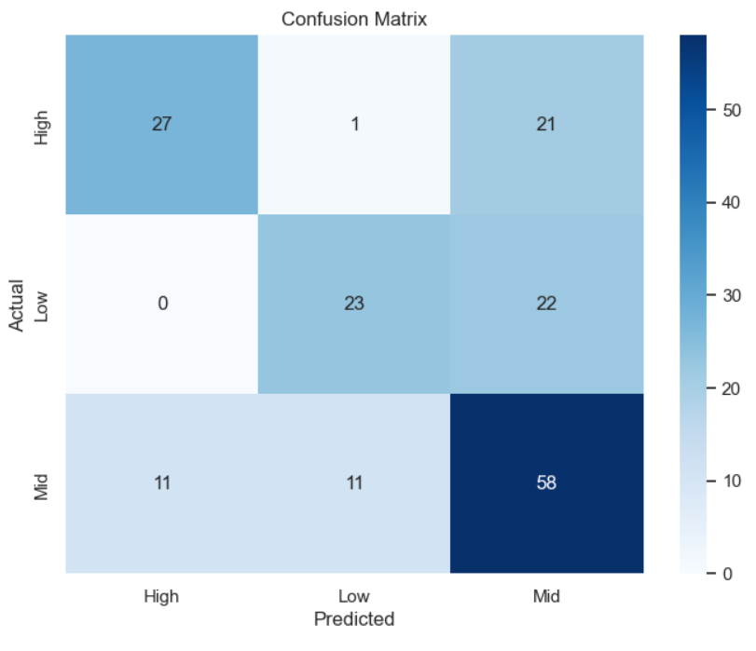
Random Forest
Price Category /Metrics (3 dp) | True Positive Rate (TPR) | True Negative Rate (TNR) | False Positive Rate (FPR) | False Negative Rate (FNR)
High | 0.551 | 0.912 | 0.088 | 0.176
Mid | 0.725 | 0.543 | 0.457 | 0.234
Low | 0.511 | 0.907 | 0.093 | 0.170
Overall | 0.620 | 0.810 | 0.190 | 0.190

Slide 14
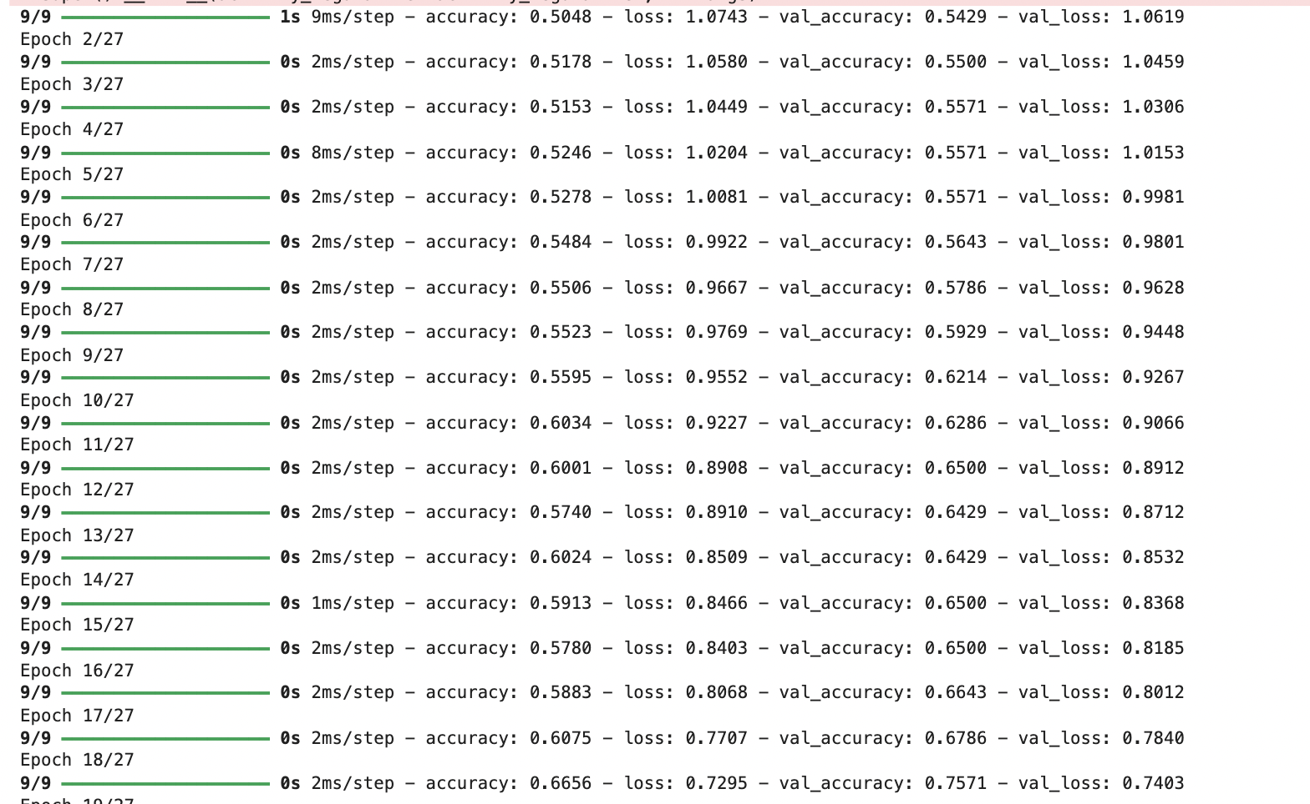
Neural Network
The features that we used to implement the Neural network includes: the brand of the phone, the ram, the internal storage and the resolution X * Y
While implementing the Neural network we had to tune the model by changing the number of layers and changing the learning rate so that we can ensure that the model is generalising well.

Slide 15
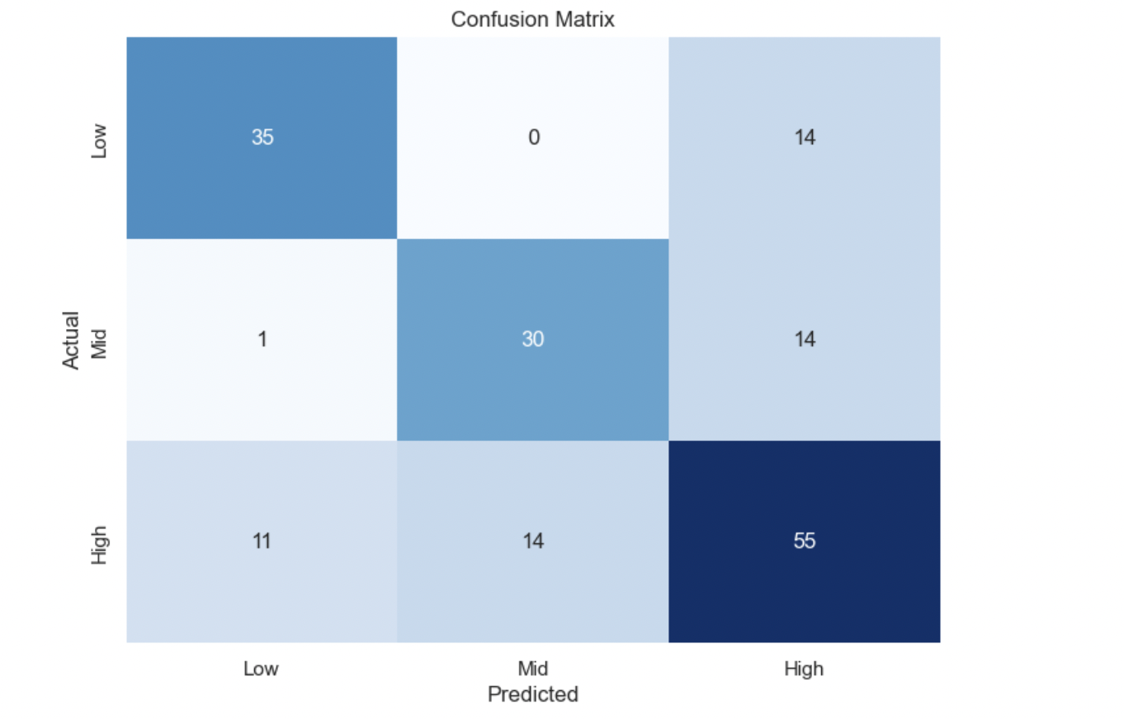
Results:
We plotted a confusion matrix and then went on to find the TPR, FPR, TNR AND FPR for each categories and the TPR and FNR for the overall model
Price Category /Metrics (3 dp) | True Positive Rate (TPR) | True Negative Rate (TNR) | False Positive Rate (FPR) | False Negative Rate (FNR)
High | 0.688 | 0.702 | 0.297 | 0.313
Mid | 0.667 | 0.891 | 0.108 | 0.333
Low | 0.714 | 0.904 | 0.096 | 0.286
Overall | 0.690 | 0.832 | 0.310 | 0.168

Slide 16
Comparison and conclusion
The neural network is able to identify more True positive cases and True negative cases overall
They both have a balanced False positive rate and False negative rate, indicating that they make error in a similar manner overall
The individual tiers have the same True positive rate, True negative rate, False positive rate and False negative rate for neural network
Neural network is more consistent than Random forest.
Why is this so?
This might be because the neural network model used a more intricate pattern to the data, leading to a better performance in some cases. Moreover, the tuning that was done for the neural network might have been also better as compared to the Random forest.
However, this might not be enough for us to decide which is a better model as our data is still very positively skewed after normalising it. Hence, we will need a more distributed data in order to better train both models and to see which model might have a better performance.

Slide 17
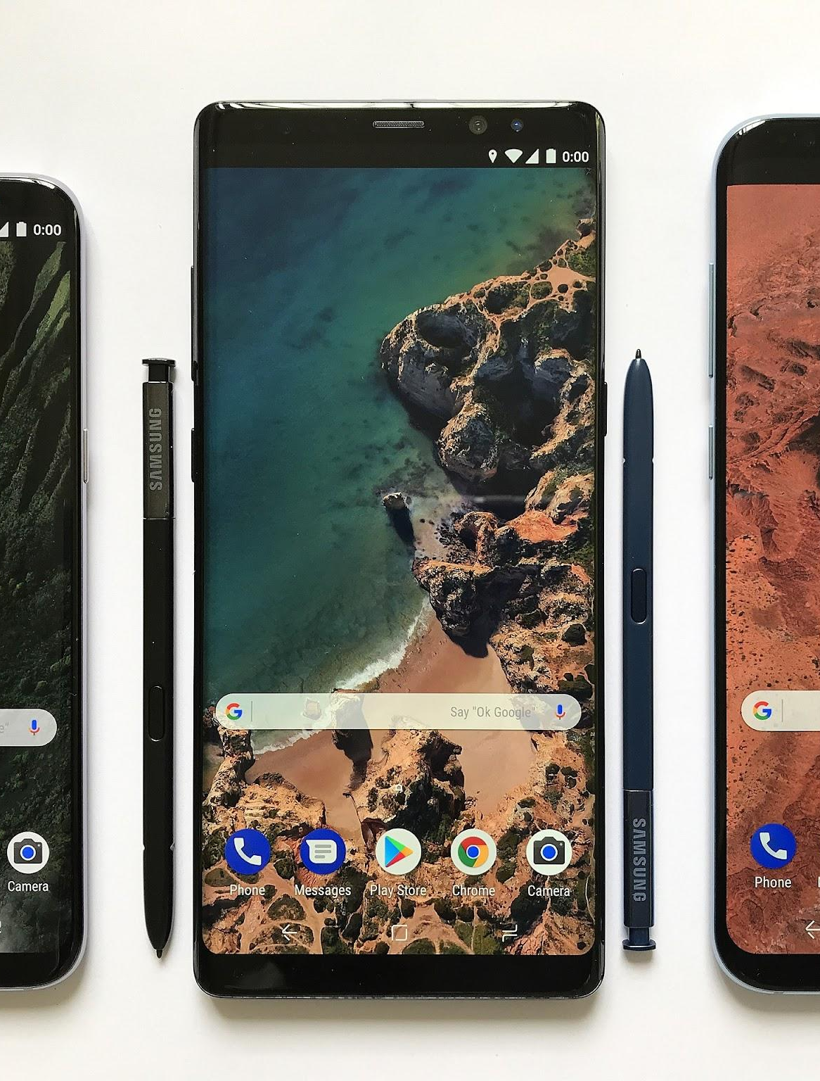
Thanks!

Slide 18
Resources
Vectors
Artificial intelligence concept twitch banner
Artificial intelligence concept youtube thumbnail
Modern mobile phone with icons background
Sites
https://www.kaggle.com/datasets/pratikgarai/mobile-phone-specifications-and-prices/data
Photos
AI-generated images by Wepik Generator

